Slide 1
Physically Based Rendering From Theory to Implementation
Chapter 8 : Reflection Models
Microfacet Models
Oren-Nayar Diffuse Reflection
Torrance-Sparrow Model
Blinn Microfacet Distribution
Anisotropic Microfacet Model
Fresnel Incidence Effects
Measured BRDFs
Irregular Isotropic Measured BRDF
Regular Halfangle Format
옥찬호 (utilForever@gmail.com)

Slide 2
Microfacet Models
Model surfaces as set of polygonal facets
Capture surface roughness effects
Microfacets can be diffuse or specular
Use facet distribution to model roughness
Statistical model of microscopic effects gives macroscopic appearance
More realistic, particularly at high incidence angles

Slide 3
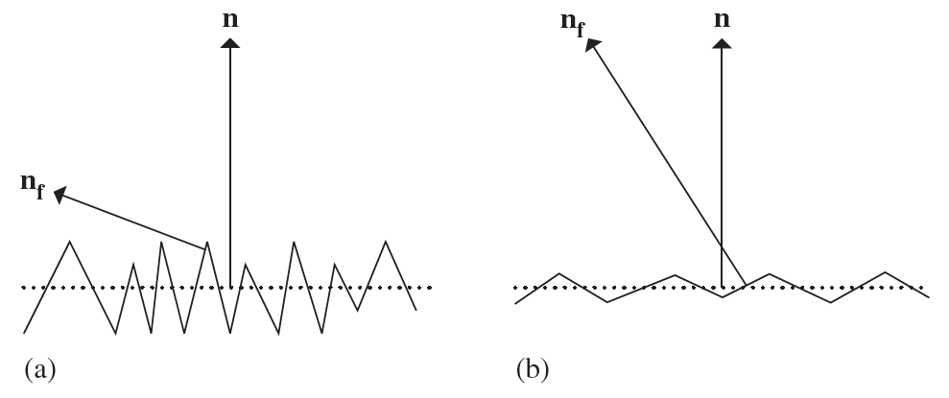
Basic Microfacet Modeling
Surface normal distribution
How the surface normal of the facets are distributed about the macroscopic normal
Facet BRDF
Are the facets diffuse or specular?

Slide 4
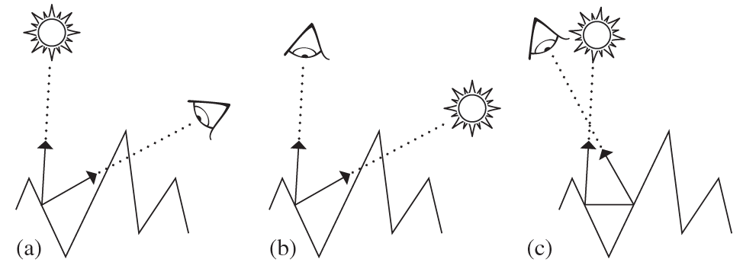
Microscopic Geometry
Masking – Viewer can’t see a microfacet
Shadowing – Light can’t see a microfacet
Interreflection – Light off one facet hits another
Aim is to capture these effects as efficiently as possible

Slide 5

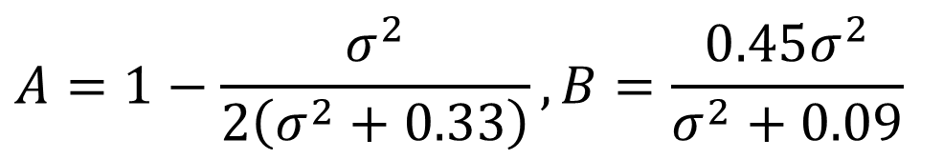

Oren-Nayar Model
Model facet distribution as Gaussian with s.d. $σ$ (raidans)
Facet BRDF is Lambertian
Resulting model has no closed form solution, but a good approximation
Sampling using cosine-weighted sampling in hemisphere
$$f_{r}\left(ω_{o},ω_{i}\right)=\frac{ρ}{π}\left(A+B\max\left(0, \cos\left(φ_{i}, φ_{o}\right)\right)\sin{α}\tan{β}\right)$$
$$A=1−\frac{σ^{2}}{2\left(σ^{2}+0.33\right)}, B=\frac{0.45σ^{2}}{σ^{2}+0.09}$$
$$α=max\left(θ_{i},θ_{o}\right), β=min(θ_{i},θ_{o})$$

Slide 6
Oren-Nayar Effects
Lambertian
Oren-Nayar

Slide 7
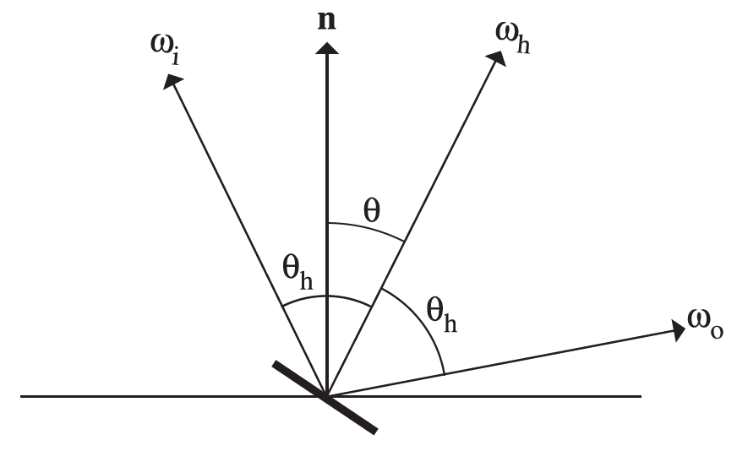
Torrance-Sparrow
Specular BRDF for facets
Arbitrary (in theory) distribution of facet normal
Additional term for masking and shadowing
Explicit Fresnel term

Slide 8
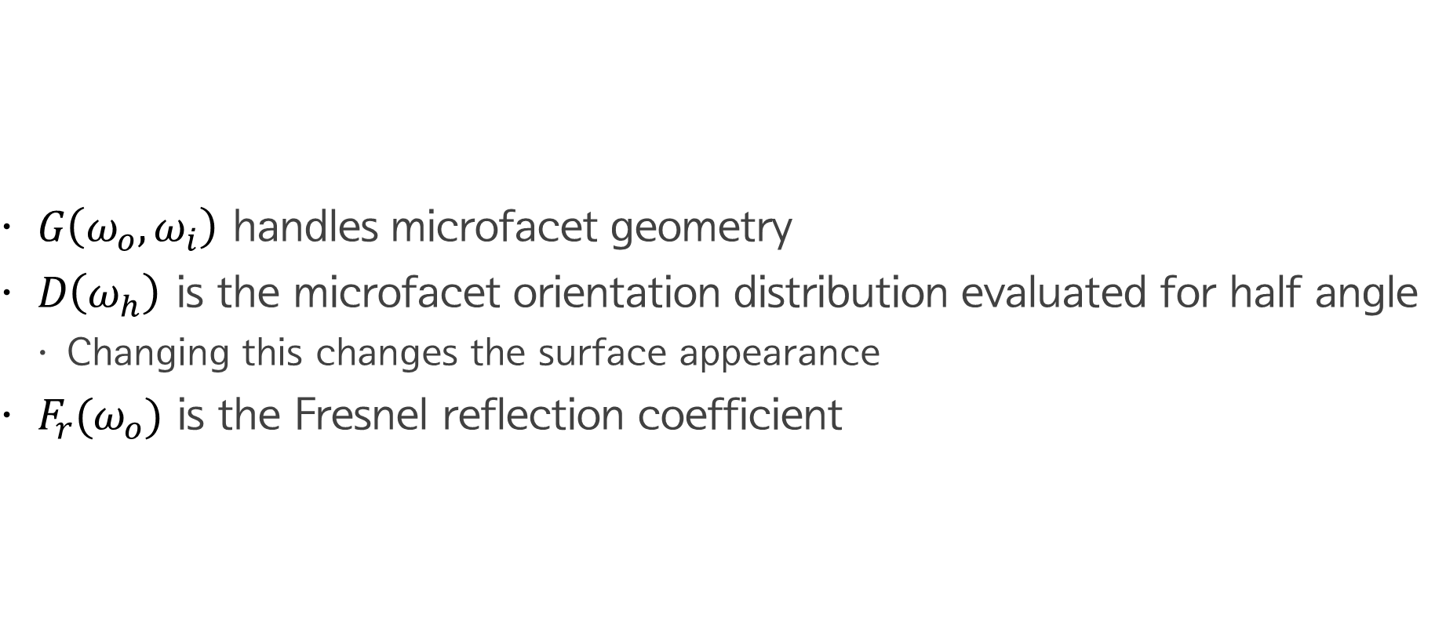
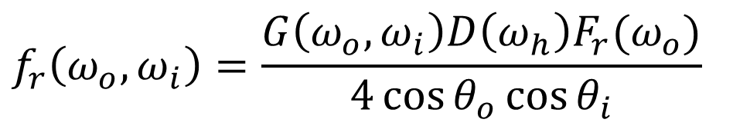
Torrance-Sparrow BRDF
$G\left(ω_{o}, ω_{i}\right)$ handles microfacet geometry
$D\left(ω_{h}\right)$ is the microfacet orientation distribution evaluated for half angle
Changing this changes the surface appearance
$F_{r}(ω_{o})$ is the Fresnel reflection coefficient
$$f_{r}\left(ω_{o}, ω_{i}\right)=\frac{G\left(ω_{o}, ω_{i}\right)D\left(ω_{h}\right)F_{r}(ω_{o})}{4\cos{θ_{o}}\cos{θ_{i}}}$$

Slide 9
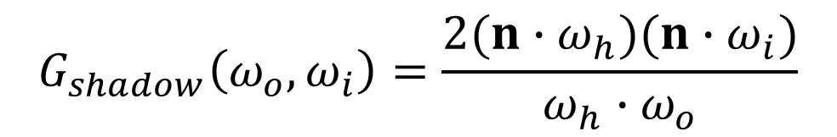
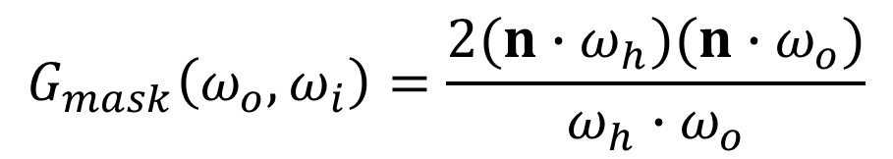
Geometry Term
Masking
Shadowing
Together
$$f_{r}\left(ω_{o}, ω_{i}\right)=\frac{G\left(ω_{o}, ω_{i}\right)D\left(ω_{h}\right)F_{r}(ω_{o})}{4\cos{θ_{o}}\cos{θ_{i}}}$$
$$G_{mask}\left(ω_{o}, ω_{i}\right)=\frac{2(n∙ω_{h})(n∙ω_{o})}{ω_{h}∙ω_{o}}$$
$$G_{shadow}\left(ω_{o}, ω_{i}\right)=\frac{2(n∙ω_{h})(n∙ω_{i})}{ω_{h}∙ω_{o}}$$
$$G\left(ω_{o}, ω_{i}\right)=min\{1,G_{mask}\left(ω_{o}, ω_{i}\right), G_{shadow}\left(ω_{o}, ω_{i}\right)\}$$

Slide 10

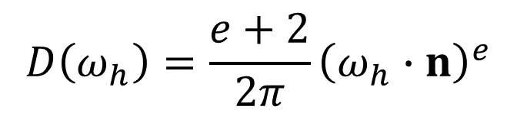
Blinn’s Microfacet Distribution
Parameter $e$ controls “roughness”
$$D\left(ω_{h}\right)=\frac{e+2}{2π}{\left(ω_{h}∙n\right)}^{e}$$

Slide 11

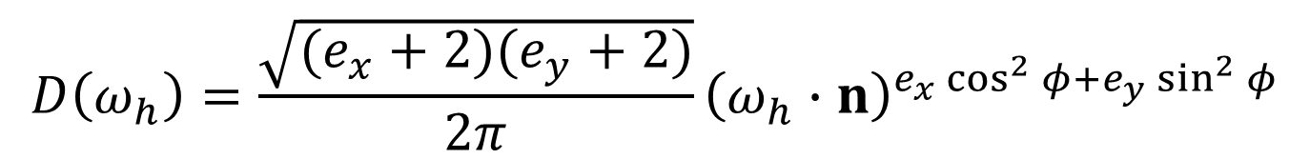
Anisotropic Microfacet Distribution
$$D\left(ω_{h}\right)=\frac{\sqrt{(e_{x}+2)(e_{y}+2)}}{2π}{\left(ω_{h}∙n\right)}^{e_{x}\cos^{2}{φ}+e_{y}\sin^{2}{φ}}$$
Parameters for $x$ and $y$ direction roughness, where $x$ and $y$ are the local BRDF coordinate system on the surface
Gives the reference frame for $φ$

Slide 12
Ashkhimin Model
Modern Phong
Phenomological, but:
Physically plausible
Anisotropic
Good for Monte-Carlo implementation

Slide 13
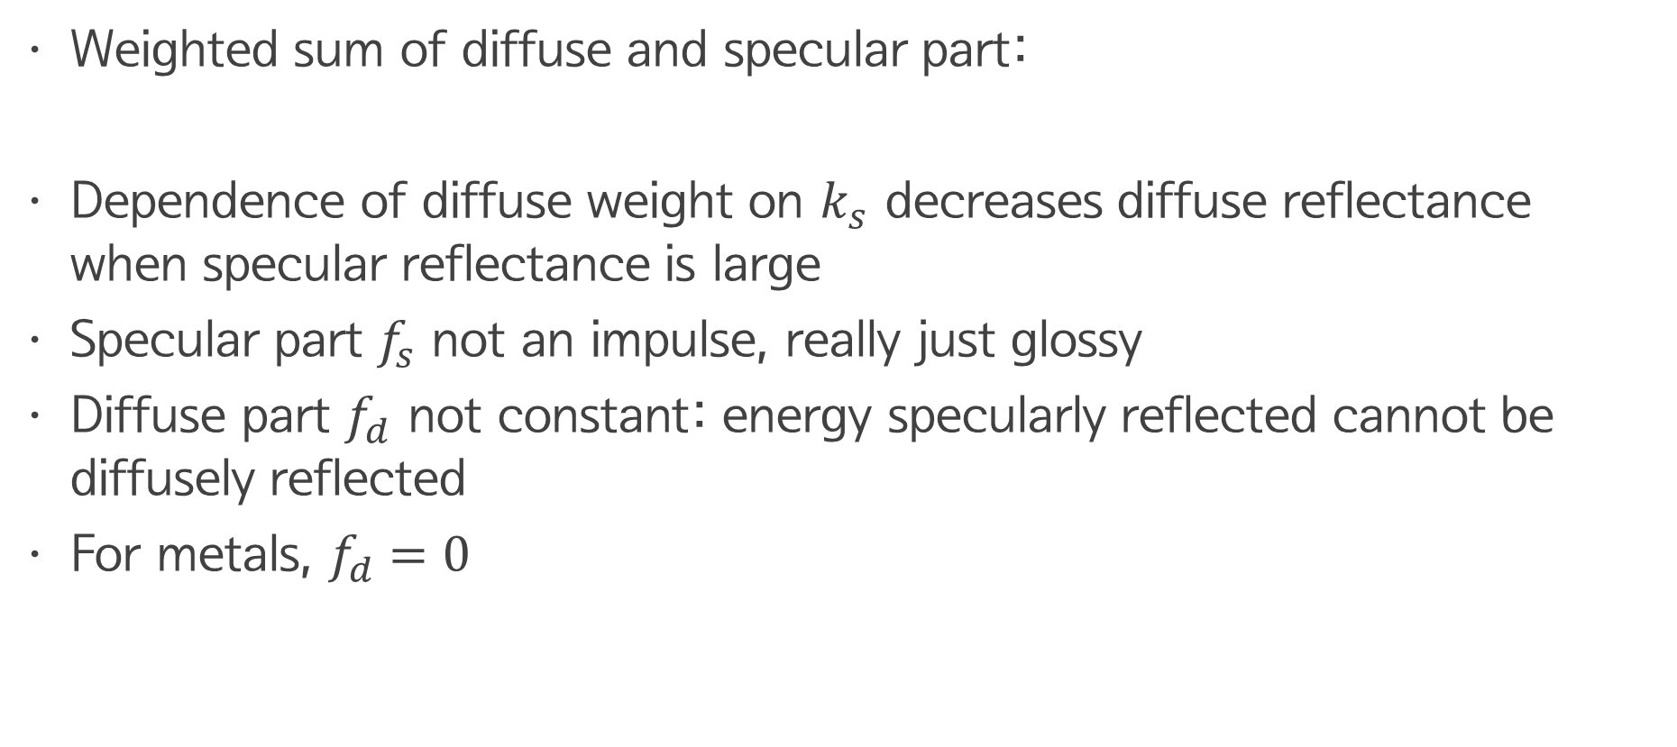
Ashkhimin Model
Weighted sum of diffuse and specular part:
Dependence of diffuse weight on $k_{s}$ decreases diffuse reflectance when specular reflectance is large
Specular part $f_{s}$ not an impulse, really just glossy
Diffuse part $f_{d}$ not constant: energy specularly reflected cannot be diffusely reflected
For metals, $f_{d}=0$
$$f_{r}\left(ω_{o}, ω_{i}\right)=k_{d}\left(1−k_{s}\right)f_{d}\left(ω_{o}, ω_{i}\right)+k_{s}f_{s}(ω_{o}, ω_{i})$$

Slide 14
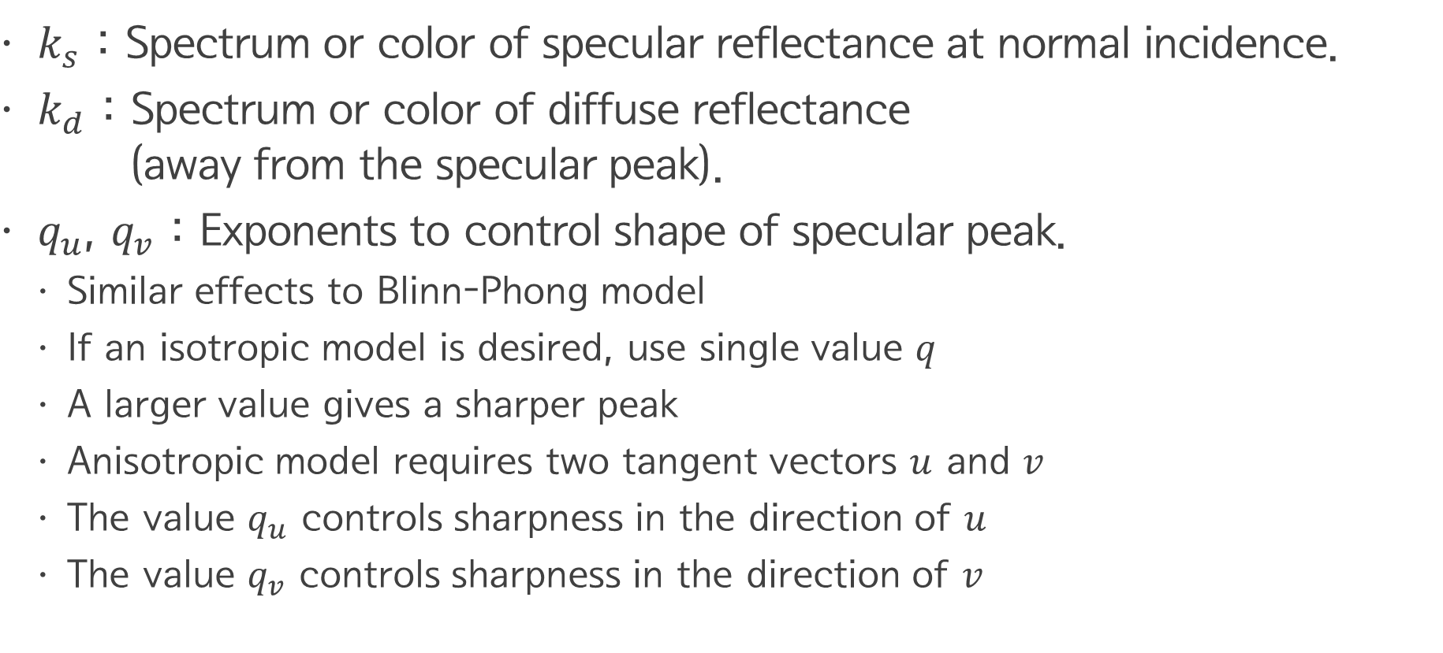
Ashkhimin Model
$k_{s}$ : Spectrum or color of specular reflectance at normal incidence.
$k_{d}$ : Spectrum or color of diffuse reflectance (away from the specular peak).
$q_{u}$, $q_{v}$ : Exponents to control shape of specular peak.
Similar effects to Blinn-Phong model
If an isotropic model is desired, use single value $q$
A larger value gives a sharper peak
Anisotropic model requires two tangent vectors $u$ and $v$
The value $q_{u}$ controls sharpness in the direction of $u$
The value $q_{v}$ controls sharpness in the direction of $v$

Slide 15

Ashkhimin Model
$φ$ is the angle between $u$ and $ω_{h}$
$$D\left(ω_{h}\right)=\sqrt{\left(q_{u}+1\right)\left(q_{v}+1\right)}{\left(ω_{h}∙n\right)}^{(q_{u}\cos^{2}{φ}+q_{v}\sin^{2}{φ})}$$

Slide 16
Ashkhimin Model
Diffuse term given by:
Leading constant chosen to ensure energy conversation
Form comes from Schlick approximation to Fresnel factor
Diffuse reflection due to subsurface scattering: once in, once out
$$f_{d}\left(ω_{o}, ω_{i}\right)=\frac{28}{23π}\left(1−{\left(1−ω_{o}∙n\right)}^{5}\right)\left(1−{\left(1−ω_{i}∙n\right)}^{5}\right)$$
$$F_{r}\left(\cos{θ}\right)=R+\left(1−R\right){\left(1−\cos{θ}\right)}^{5}$$

Slide 17
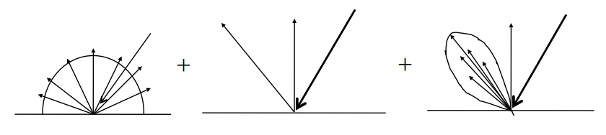
Complex BRDF
Combination of the three.

